Slide 1
CMS
Go-Live Plan

Slide 2
Content batch status for ADGM.com
Page Types | Batch No. | Total Pages | With Gravitas for content population & QA | Feedback Provided to Gravitas | Pending TS review | Pending Marcoms review | Signed-off by Marcoms | %Complete | Date of TS submission to Marcoms | Target date for Marcoms to finish review | Target date for Business to finish review
 | Batch-3 | 22 | 0 | 1 | 0 | 1 | 20 | 91% | 18/09 | 20/09 | 11/10
Events & Forms | Batch-4 | 117 | 31 | 1 | 0 | 75 | 10 | 9% | 18/09 | 25/09 | 11/10
Operating & Setting Up | Batch-5 | 113 | 41 | 16 | 0 | 19 | 37 | 33% | 23/09 | 30/09 | 11/10
Public Register & Announcements | Batch-6 | 1235 | 1202 | 0 | 0 | 33 | 0 | 0% | 18/09 – FSRA 20/09 - Announcement | 30/09 11/10 | 11/10 NA
Points to note.
Batch 1 & 2 are complete 100% so removed from the table.
Keeping in mind that the final Go-Live date is 28th Oct, we have moved the batch review completion date to 11th Oct from 4th Oct, giving more time for Business users to complete their review.
In Batch-6, we have,
  486 public register pages. We are targeting to submit these pages by 18/09. Since they have same template, we suggest for Marcoms and FSRA business users to do testing / review in parallel to complete these pages by 11/10.
  746 announcement pages. For the 746 announcement pages, we will be focusing on migrating from 2024 up-to year 2023 by 20/09. Since these pages will be reviewed by Marcoms only, they can complete the review by 11/10.
  For announcements, older that 2023, we will share the submission date next week.
Please let me know if this is clear and enough for the summary.
I will further share the expectations from Marcoms & TS later today.

Slide 3
Key Dependencies & Milestones for Marcoms
Task | Target Date | Comments
Communication 1 | 16th Sep | Authority users to start tracking all their changes in the tracker shared by Marcomms. Access to utility pages (see slide 4) for authority users will be removed on 27th on Sitecore. Post 27th Sep, for any changes required on the Utility pages, users will raise requests to TS for the changes will be done on both Sitecore & Optimizely by project team.
Batch review completion | 11th Oct | Batch reviews must be completed by this date on pre-prod with all the feedback provided to project team.
Production Validation | 15th Oct – 23rd Oct | Both business & Marcoms must do sanity checks on the Production environment
Go – No Go decision | 23rd Oct | After all the validation is done final Go-No Go decision needs to be taken by Marcoms, Business users & Technology Services
Switch Over, Go-Live & Launch Communication | 28th Oct | This is as per the brand launch date

Slide 4
List of Utility Pages
Item |  | SME / Content Authors
ADGM-Courts - Hearing List | ADGM Courts' Hearings | Nicola, Israa, Georgia
ADGM-Courts - Judgement List | ADGM Courts’ Cases | Nicola, Israa, Georgia
ADGM-Courts - Cases | ADGM Courts’ Cases | Nicola, Israa, Georgia
FSRA (4 Utilities) - FSF, RB, RB, CIF | ADGM Financial Services Regulatory Authority Public Register | Mannar, Jacinta
RA - Public Notices | ADGM Registration Authority Public Notices | Lisa, Rola, Sumaya
FAQs | ADGM Frequently Asked Questions (FAQs) | Nada, Dan, RJ

Slide 5
Appendix

Slide 6
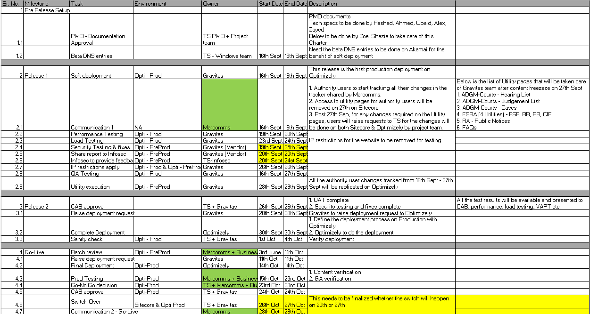
Go-Live Plan

